Slide 1
Embedded systems and IOT
1
Lab 1
Part 2

Slide 2
How to Properly Implement
2
Logic Circuit
on Breadboard
without Implementation Errors
(Lab Guide)

Slide 3
Sources of Implementation Errors
3
ICs are not well fitted
ICs Broken Pins
Wrong Pins Enumeration Wrong Polarity (specially LEDs) Missed Connections Connections to Wrong ICs Pins
No Power is Supplied to ICs
Float Inputs (Not connected Pins are wrongly assumed as Logic “0”)

Slide 4
ICs are not well fitted
4

Slide 5
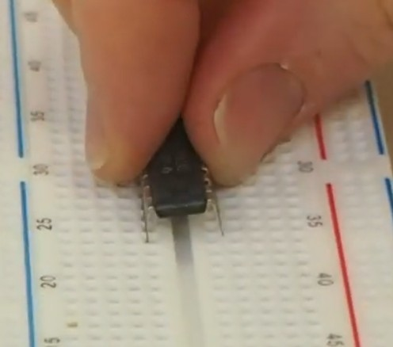
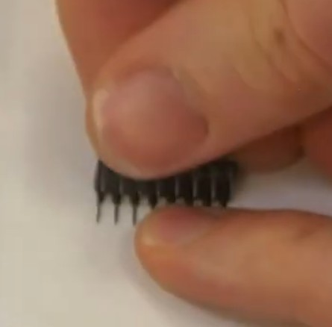
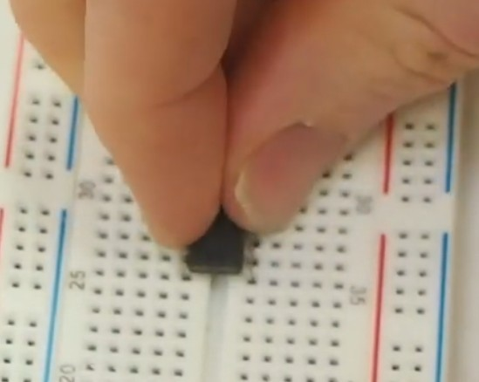
Fit ICs on the Breadboard
5
For Brand New ICs, Adjust Pins spacing in order to be smoothly fitted in breadboard
1
2
3
X
√

Slide 6
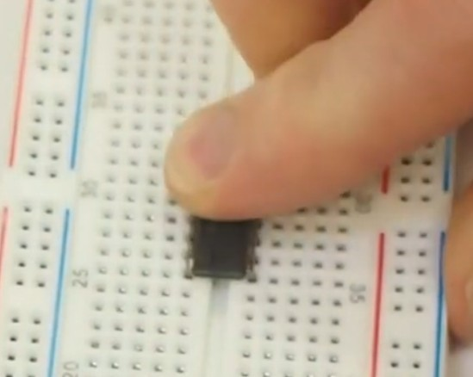
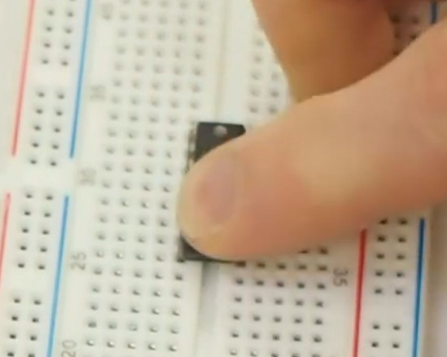
Fit ICs on the Breadboard
6
Push from both sides to make sure all pins are fitted
141
5

Slide 7
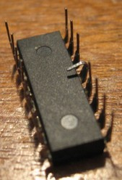
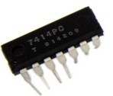
ICs Broken Pins
7
Take care during Pull Up the ICs from Breadboard

Slide 8
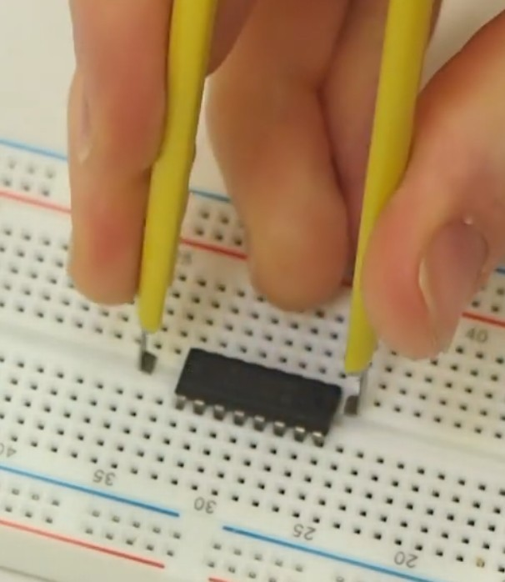
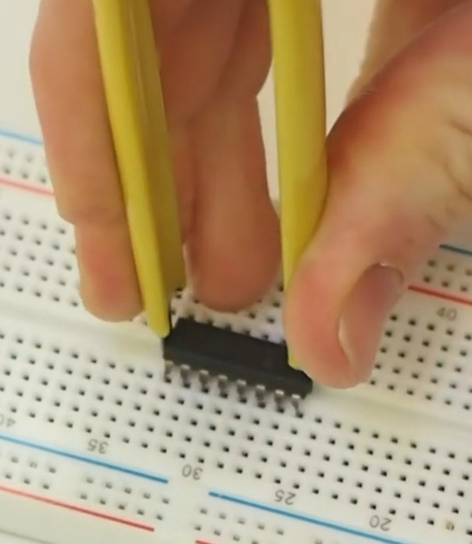
Use Proper Tool to Pull Up Chips from Breadboard
8

Slide 9
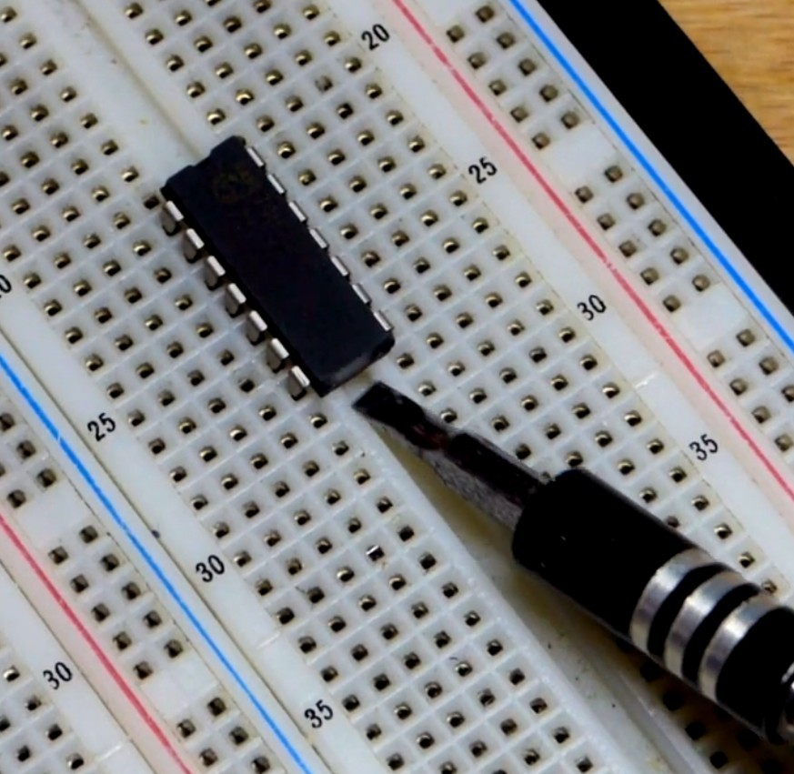
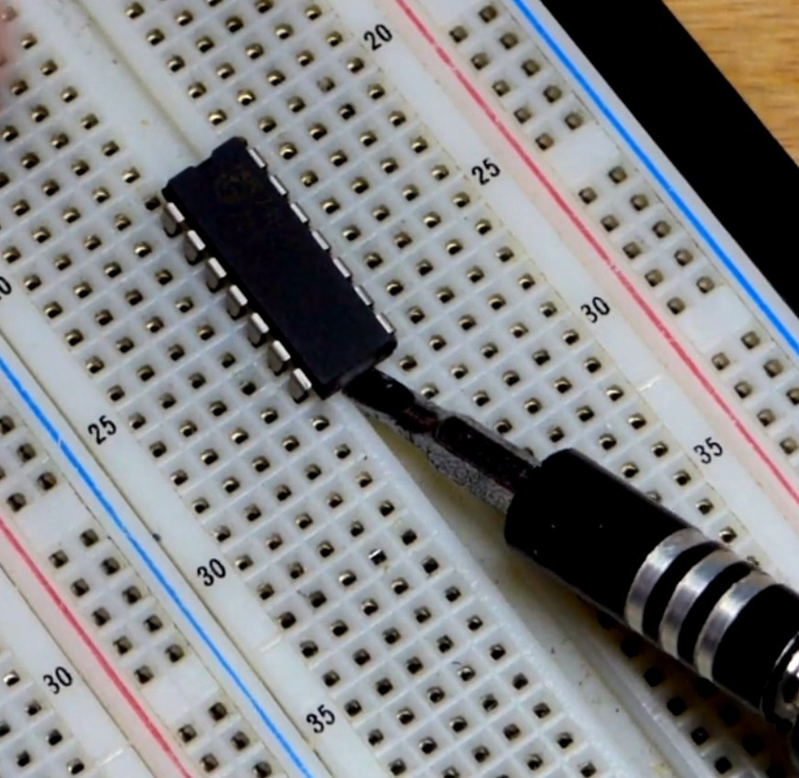
Use flat small screw driver
9
1

Slide 10
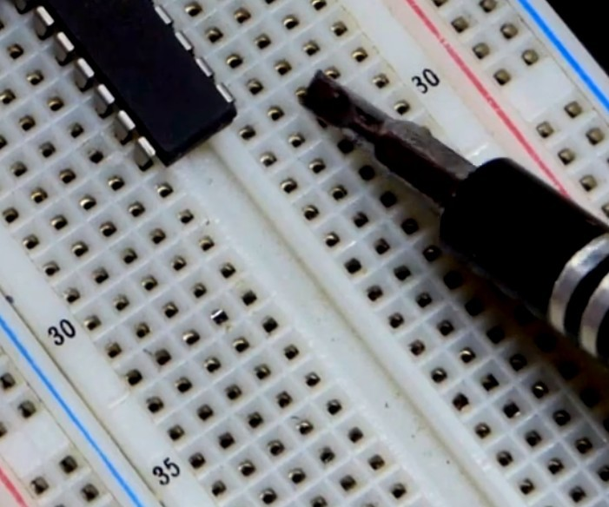

Use flat small screw driver
10
Twist the screw driver with care
2

Slide 11
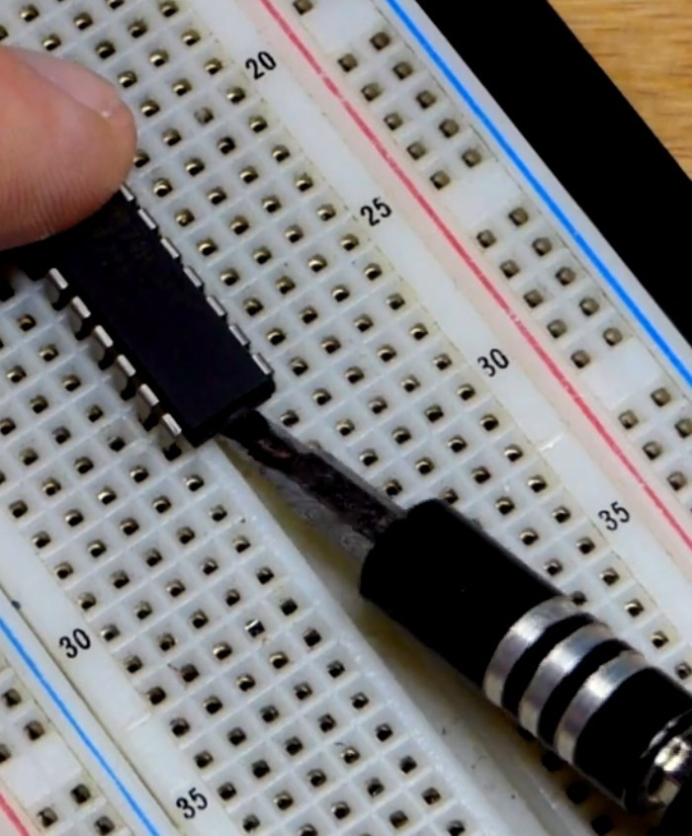
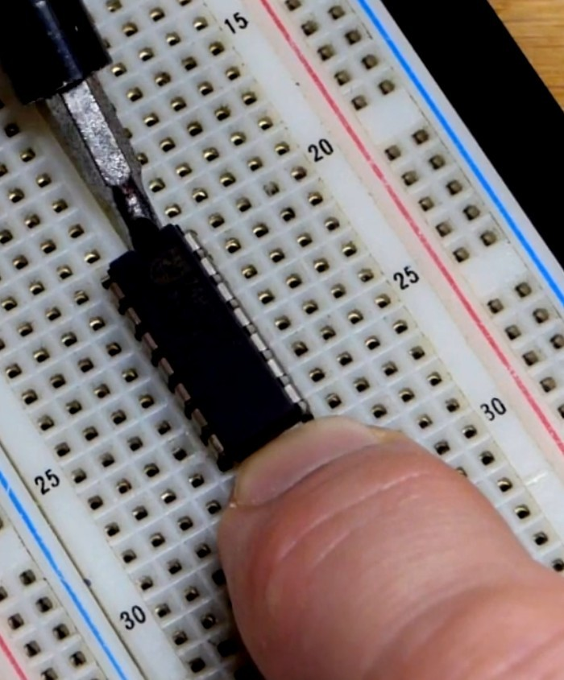
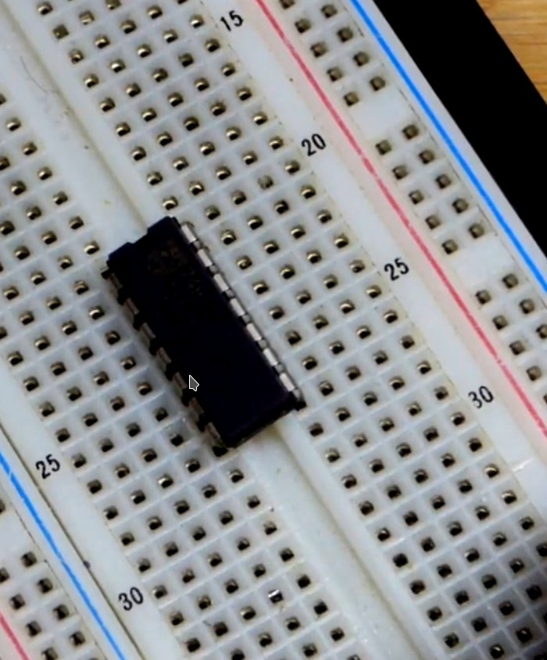
Use flat small screw driver
11
Repeat from Both Sides – Use fingers for support
3

Slide 12
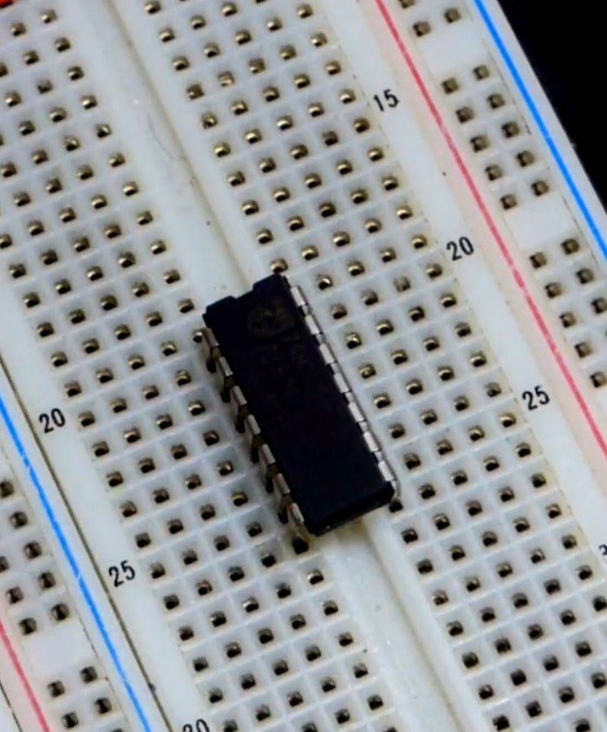
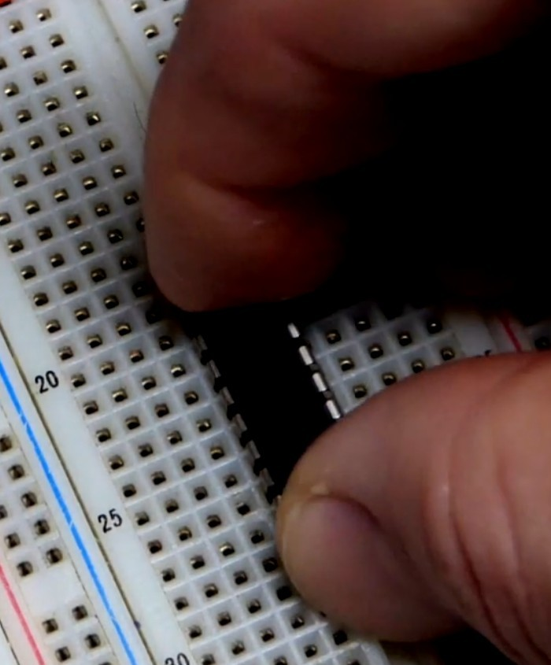
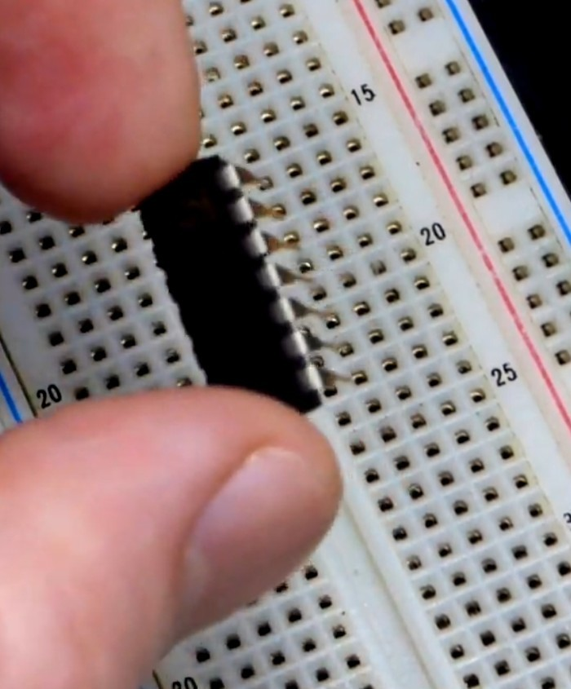
Use flat small screw driver
12
When being Loose , Pull-up with your fingers
4

Slide 13
Wrong Pins Enumeration
13

Slide 14
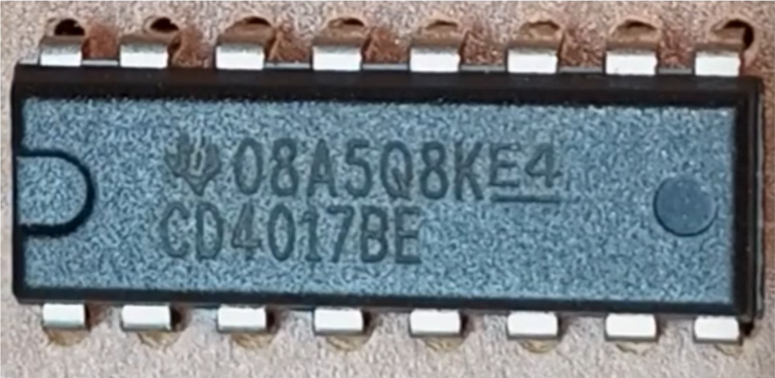
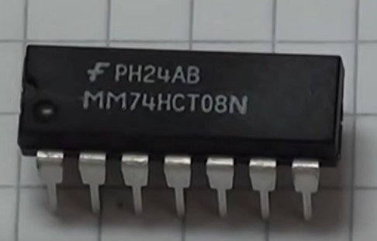
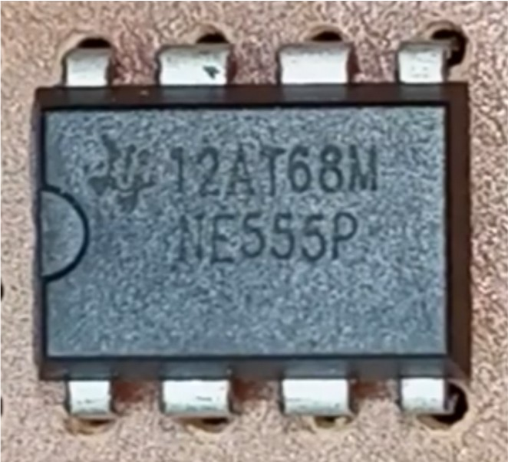
End
14
16
9
X
Counter clockwise
1
8
Start
1 2 3 4 5 6 7

Slide 15
Wrong Polarity (of LEDs)
15

Slide 16
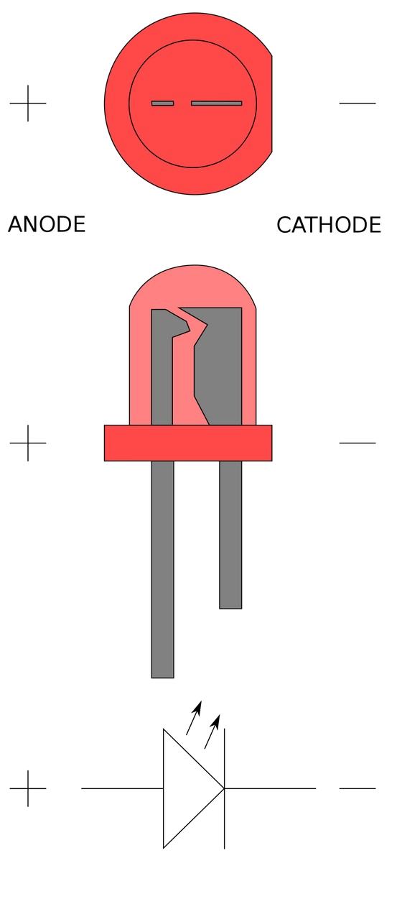
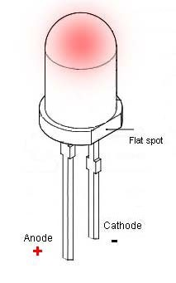
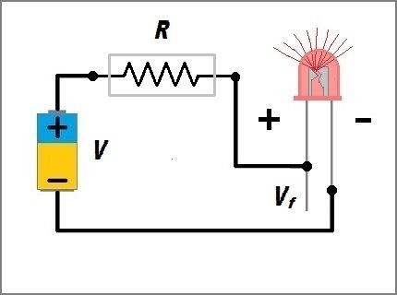
Led Polarity
16
+
-
+
-
220 to 560
Ohm
+
-
Remember to add resistor in series with LED

Slide 17
How to Implement a Given design
17
without errors
NO Missed Connections
NO Connections to Wrong ICs Pins

Slide 18
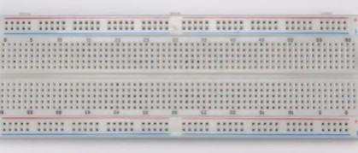
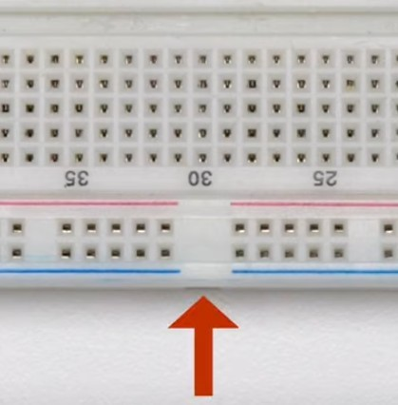
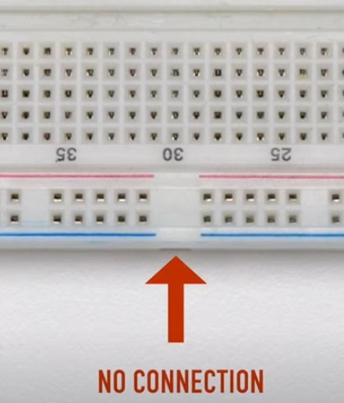
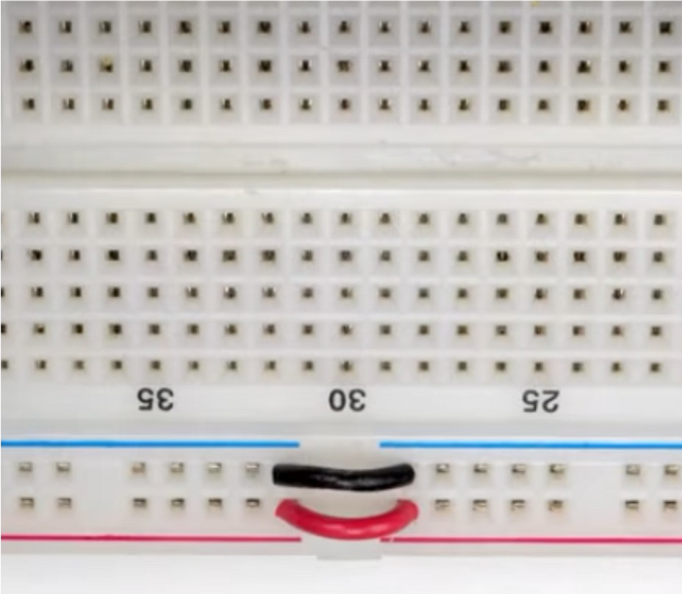
23
You have to connect The two segments Manually

Slide 19
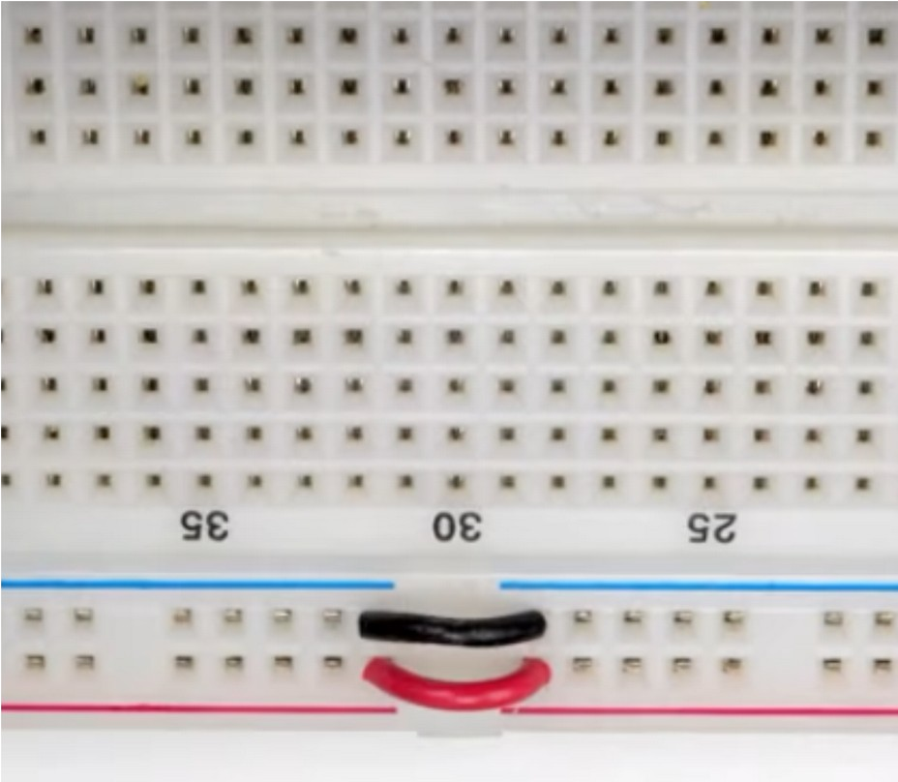
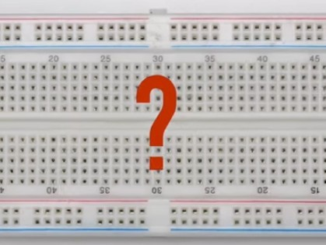
24

Slide 20
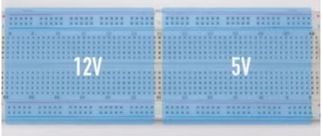
25
Flexibility to use TWO different Voltages

Slide 21
26
Float inputs
(Not connected Pins are wrongly assumed as Logic “0”)

Slide 22
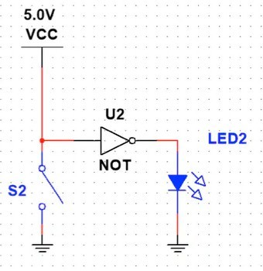
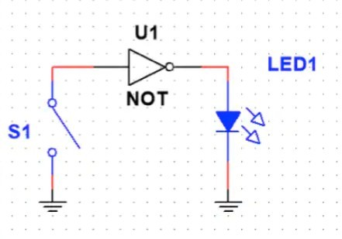
Float and Non-float Inputs
27
Open Switch
Float Input (Noise Based)
Closed Switch GND Input ==”0”
Open Switch VCC Input ==”1”
Closed Switch GND Input ==”0”

Slide 23
Float and Non-float Inputs
28
Open Switch
Float Input (Noise Based)
Closed Switch GND Input ==”0”
Open Switch VCC Input ==”1”
Closed Switch GND Input ==”0”
Closed Switch
==
Short Circuit ???

Slide 24

Float and Non-float Inputs
29
Opened Switch Float Input
(Noise Based)
Closed Switch GND Input ==”0”
Opened Switch VCC Input ==”1”
Closed Switch GND Input ==”0”
Closed Switch
==
NO Short Circuit

Slide 25
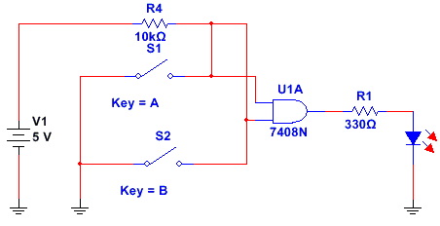
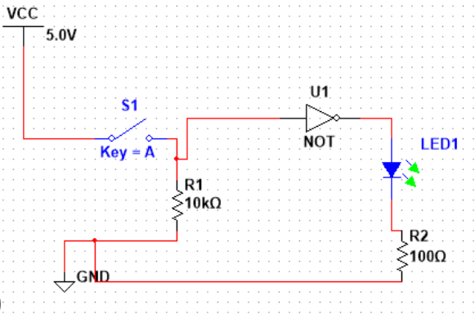
Float and Non-float Inputs
30
Pull Up and Pull Down Resistors
Pull UP Resistor
Pull Down Resistor
Opened Switch VCC Input == “1”
Closed Switch GND Input ==”0”
Opened Switch GND Input == “0”
Closed Switch VCC Input ==”1”

Slide 26
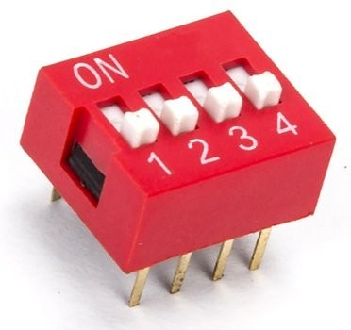
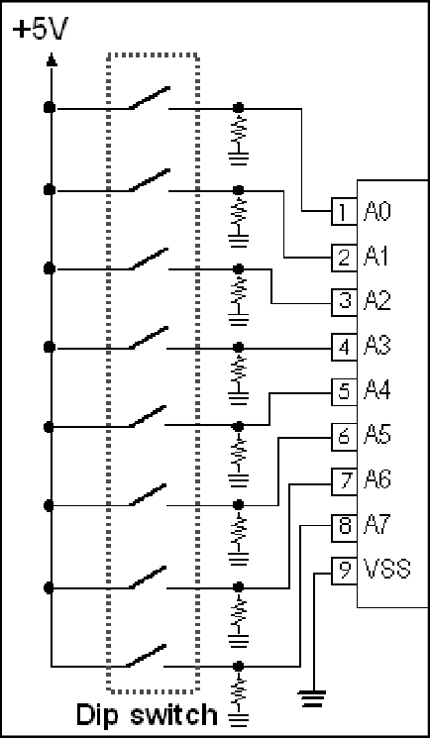
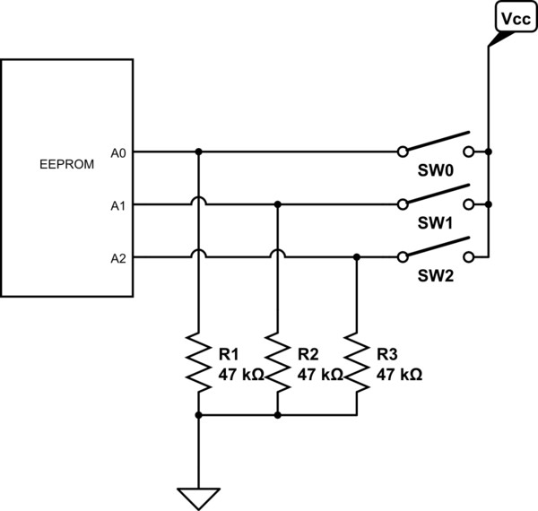
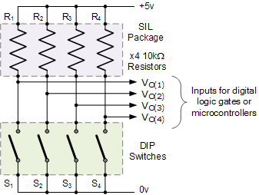
Float and Non-float Inputs
31
Dip Switches with Pull Up and Pull Down Resistors
Pull Down Resistors
Pull UP Resistors

